Slide 1
Objectives
In this session, you will learn to:
  Create a trendline
  Create scenarios
  Perform what-if analysis
  Perform statistical analysis
  Publish a worksheet to the web
  Import data from the web
Notes:
Share the objectives with the students.

Slide 2
Create a Trendline
To forecast future values based on the chart data, you can create a trendline.
Trendlines:
  Are the graphical representation of trends in a data series that allows you to study predictions in data.
  Can be added to data series in column, line, bar, area, stock, or bubble charts.
  Are of the following six types:
    Exponential
    Linear
    Logarithmic
    Polynomial
    Power
    Moving Average
Notes:
Additional Input:
You can use the following link that explains how to add, change, or remove a trendline in a Excel chart:
http://office.microsoft.com/en-us/excel/HP051984621033.aspx?pid=CH010003771033

Slide 3
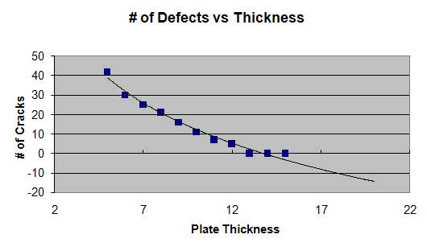
Create a Trendline (Contd.)
The following figure shows a trendline.
Polynomial trendline
to graphically represent
data in a series
Trendline Forecasting
Future Data
Trends in
Existing Data
Notes:
You can use the following link for more information on how to add a trendline to an Excel chart.
http://www.tech-recipes.com/rx/2097/excel_2007_how_to_add_trendline_chart

Slide 4
Demo: Creating a Trendline
Scenario:
  You need to forecast the thickness of plates which, when manufactured, will be of good quality and will have fewer cracks. You have a scatter plot chart to use for your reports. You find that there is a sudden decrease in the value in the chart, and then it levels out. You need to forecast the data graphically by applying a dark red color and a dash style.

Slide 5
Demo: Creating a Trendline (Contd.)
Solution:
  To solve the preceding scenario, you need to perform the following tasks:
    Add a trendline that will forecast the plate thickness data forward five units.
    Apply line color and line style to the trendline.
Notes:
Discuss the scenario of Activity 4-1 of Lesson 3 in the Student Guide with the students.
You can access the data file for this activity from the following path in the TIRM CD:
TIRM\DATAFILES FOR FACULTY\LEVEL 3\Session_03\Analyzing Data\Pottery Performance.xlsx

Slide 6
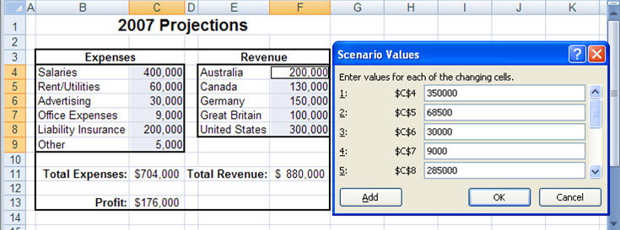
Create Scenarios
To forecast different values based on the criteria set, you can create scenarios.
A scenario is a set of input values that are substituted for the primary data in a worksheet.
The following figure shows a scenario created for the worksheet containing the primary data.
Primary
Data
Set of input values that
can be substituted
for primary data
Notes:
You can use the following link for more information and examples on Scenarios in Excel 2007.
http://www.homeandlearn.co.uk/excel2007/excel2007s7p3.html

Slide 7
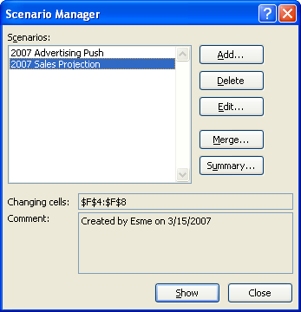
Create Scenarios (Contd.)
The Scenario Manager dialog box allows you to create, edit, delete, and merge scenarios.
The following figure shows the different options of the Scenario Manager dialog box.

Slide 8
Demo: Creating Scenarios
Scenario:
  You would like to analyze the expense and revenue data of the previous year, and want to forecast a particular outcome and plan accordingly for the current year. You would like to retain the value of the existing data and compare this with a situation where the advertising budget is increased by $40,000 and each country’s revenue by 10 percent.

Slide 9
Demo: Creating Scenarios (Contd.)
Solution:
  To solve the preceding scenario, you need to perform the following tasks:
    Create a scenario that maintains the original projection numbers for 2007.
    Create another scenario to specify the values for the first range of cells.
    Specify the values for the second range of cells.
    Test your work.
Notes:
Discuss the scenario of Activity 4-2 of Lesson 3 in the Student Guide with the students.
You can access the data file for this activity from the following path in the TIRM CD:
TIRM\DATAFILES FOR FACULTY\LEVEL 3\Session_03\Analyzing Data\2007 Projections.xlsx

Slide 10
Perform What-If Analysis
The Solver option:
  Is used to set the value stored in a single cell that has a formula, to a specified value.
  Allows you to either retain the Solver solution or restore the original values.
You can perform what-if analysis to forecast potential values by changing variables in formulas without affecting your original data.
Notes:
Use the following link for more information and examples on Goal Seek in Excel 2007.
http://www.homeandlearn.co.uk/excel2007/excel2007s7p4.html

Slide 11
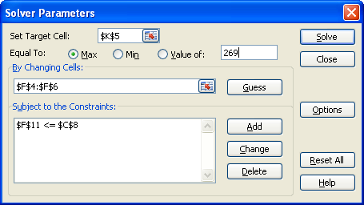
Perform What-If Analysis (Contd.)
The Solver Parameters dialog box consists of options that can be used to set the solver parameters.
The following figure shows the various options of the Solver Parameters dialog box.

Slide 12
Demo: Using Goal Seek to Analyze Data
Scenario:
  You have developed a worksheet named Loan Schedule that amortizes a car loan. The worksheet currently amortizes a $24,000 loan over 60 months with a 12 percent interest rate. However, after reviewing some of your other monthly expenses, you have come to realize that you can only afford a $17,500 loan with a monthly payment set at $350.00. You need to determine the term of the loan based on this new data.

Slide 13
Demo: Using Goal Seek to Analyze Data (Contd.)
Solution:
  To solve the preceding scenario, you need to perform the following tasks:
    Decrease the value of the principal loan amount.
    Find the new loan term for the defined principal amount and monthly payment of $350.
Notes:
Discuss the scenario of Activity 4-3 of Lesson 4 in the Student Guide with the students.
You can access the data file for this activity from the following path in the TIRM CD:
TIRM\DATAFILES FOR FACULTY\LEVEL 3\Session_03\Analyzing Data\Loan Schedule.xlsx

Slide 14
Demo: Using Solver to Analyze Data
Scenario:
  A windfall has come your way and you can now afford to spend a little more on your new car. Based on other expenses in your long-term budget, you have decided that you can now afford a $500 monthly payment as long as the interest rate stays between 10 and 15 percent, and your payments are for less than 36 months. Now, you want to find out how much you can borrow.

Slide 15
Demo: Using Solver to Analyze Data (Contd.)
Solution:
  To solve the preceding scenario, you need to perform the following tasks:
    Load the Solver add-in.
    Change the monthly payment from $350 to $500.
    Specify the cells with the principal amount value, interest rate, and term in months as changing cells.
    Add constraints to set the interest rate between 10 between 15 percent, and the term to be less than35 months.
    Calculate the new principal amount.
Notes:
Discuss the scenario of Activity 4-4 of Lesson 4 in the Student Guide with the students. Before you being open My Loan Schedule.xlsx

Slide 16
Perform Statistical Analysis with the Analysis ToolPak
The Analysis ToolPak:
  Is an add-in that contains a wide variety of tools to help you perform statistical analysis.
  Includes tools to create:
    Histograms.
    Derive random samples.
    Perform regression analysis.
To derive the desired value from complex data sets, you can perform statistical analysis using the tools available in the Analysis ToolPak.

Slide 17
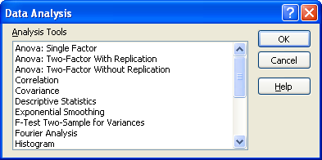
Perform Statistical Analysis with the Analysis ToolPak (Contd.)
The following figure shows the tools available in the Analysis ToolPak.
Tools to perform
sophisticated
statistical analysis

Slide 18
Demo: Performing Statistical Analysis
Scenario:
  Your company has collected the names of 60 people who are willing to participate in a focus group to help you refine your flagship product. However, you can only have 10 people in the focus group. The team overseeing the focus group needs a way to randomly select 10 people from the list of 60. The random list needs to include the focus group candidates’ ID number and last name.

Slide 19
Demo: Performing Statistical Analysis (Contd.)
Solution:
  To solve the preceding scenario, you need to perform the following tasks:
    Load the Analysis ToolPak add-in.
    Open the Sampling analysis tool.
    In a new worksheet, create a random sample of 10 people.
    In the new worksheet, look up the last name of each unique ID.
    Display the last name for all the unique IDs in the worksheet.
Notes:
Discuss the scenario of Activity 4-5 of Lesson 4 in the Student Guide with the students.
You can access the data file for this activity from the following path in the TIRM CD:
TIRM\DATAFILES FOR FACULTY\LEVEL 3\Session_03\Analyzing Data\Randomize.xlsx

Slide 20
Create a Workspace
A workspace:
  Is an Excel file that contains location, screen size, and screen position data about multiple workbooks.
  File is saved with the .xlw extension.
  Can be used to manage related sets of data that span across multiple workbooks.

Slide 21
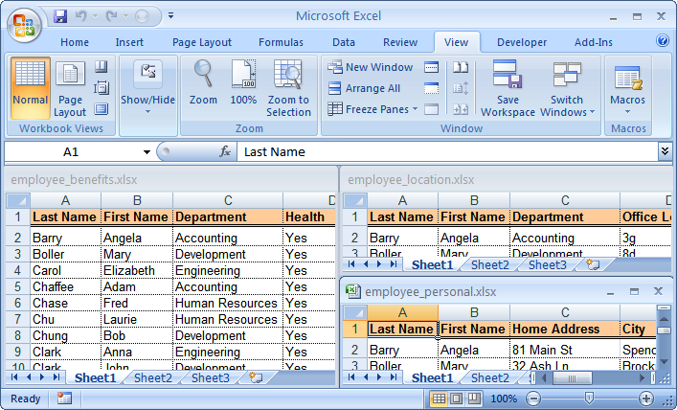
Create a Workspace (Contd.)
The following figure shows a workspace file.
A workspace containing the
location, screen size, and
screen position data of
multiple workbooks

Slide 22
Demo: Creating a Workspace
Scenario:
  You are in charge of updating employee information that is stored in three different workbooks. You have found that as your company grows, you are using these three workbooks together all the time. You want to create a single source that can open all three workbooks at the same time, with the display intact, whenever required.

Slide 23
Demo: Creating a Workspace (Contd.)
Solution:
  To solve the preceding scenario, you need to perform the following tasks:
    Arrange all open windows vertically.
    Create a workspace.
    Test your work.
Notes:
Discuss the scenario of Activity 5-1 of Lesson 5 in the Student Guide with the students.
You can access the data files for this activity from the following path in the TIRM CD:
TIRM\DATAFILES FOR FACULTY\LEVEL 3\Session_03\Working with Multiple Workbooks\Employee Personal.xlsx
TIRM\DATAFILES FOR FACULTY\LEVEL 3\Session_03\Working with Multiple Workbooks\Employee Benefits.xlsx
TIRM\DATAFILES FOR FACULTY\LEVEL 3\Session_03\Working with Multiple Workbooks\ Employee Location.xlsx

Slide 24
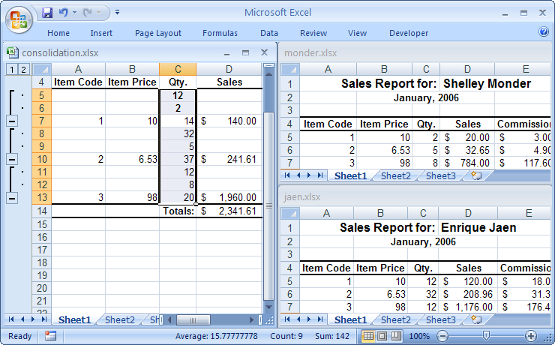
Consolidate Data
Data consolidation is the method of summarizing data from several ranges into a single range.
The following figure shows data consolidation from multiple workbooks into a single worksheet.
Data summarized
from
several ranges
into one range
Workbook
with similar
statistical data

Slide 25
Consolidate Data (Contd.)
The Consolidate dialog box:
  Consists of the following options that are used to consolidate data.
    Function
    Reference
    Browse
    All References
    Add
    Delete
    Use Labels In
    Create Links To Source Data

Slide 26
Demo: Consolidating Data
Scenario:
  You have three sales reports (Hanover, Monder, and Jaen) that need to be summarized. You need to consolidate the data in the Consolidation workbook. You will consolidate the range that contains the quantity data on each of the worksheets in the consolidation worksheet.

Slide 27
Demo: Consolidating Data (Contd.)
Solution:
  To solve the preceding scenario, you need to perform the following tasks:
    In the Consolidation workbook, select the range where you want the consolidated data to be placed.
    Reference the range that has the quantity data, from the Monder workbook.
    Reference the range that has the quantity data from the Jaen workbook and the Hanover workbook.
    Create links to the source data.
    View the hidden data in the consolidated workbook.
Notes:
Discuss the scenario of Activity 5-2 of Lesson 5 in the Student Guide with the students.
You can access the data files for this activity from the following path in the TIRM CD:
TIRM\DATAFILES FOR FACULTY\LEVEL 3\Session_03\Working with Multiple Workbooks\Hanover.xlsx
TIRM\DATAFILES FOR FACULTY\LEVEL 3\Session_03\Working with Multiple Workbooks\Monder.xlsx
TIRM\DATAFILES FOR FACULTY\LEVEL 3\Session_03\Working with Multiple Workbooks\Consolidation.xlsx

Slide 28
Link Cells in Different Workbooks
You an link cells in different workbooks to connect the data stored in one workbook to the data in another workbook.
  The linked cells can smooth the workflow by removing the need to open workbooks that contain related data.

Slide 29
Demo: Linking Cells in Different Workbooks
Scenario:
  You need to calculate the total sales and total commission for the three sales representatives whose data is stored in the Finch, Decker, and Weckl workbooks, respectively. You have already begun developing the Summary workbook that will summarize and calculate the total for each of the files. Any update to the sales data in any of the files should be reflected in the Summary workbook.

Slide 30
Demo: Linking Cells in Different Workbooks (Contd.)
Solution:
  To solve the preceding scenario, you need to perform the following tasks:
    Create a formula that sums the sales totals from each of the sales representatives’ worksheets.
    Update the sales data for Item 3 in finch.xlsx.
Notes:
Discuss the scenario of Activity 5-3 of Lesson 5 in the Student Guide with the students.
You can access the data files for this activity from the following path in the TIRM CD:
TIRM\DATAFILES FOR FACULTY\LEVEL 3\Session_03\Working with Multiple Workbooks\Finch.xlsx
TIRM\DATAFILES FOR FACULTY\LEVEL 3\Session_03\Working with Multiple Workbooks\Decker.xlsx
TIRM\DATAFILES FOR FACULTY\LEVEL 3\Session_03\Working with Multiple Workbooks\Weckel.xlsx
TIRM\DATAFILES FOR FACULTY\LEVEL 3\Session_03\Working with Multiple Workbooks\Summary.xlsx

Slide 31
Edit Links
Cells in different can be linked to connect the data stored in one workbook to the data in another workbook.
You edit the links to change the reference to a linked cell in your source workbook:
  Editing links can minimize upkeep time because you don’t have to create a new link from scratch.
Notes:
You can use the following link that shows how to insert hyperlinks in Excel 2007:
http://www.homeandlearn.co.uk/excel2007/excel2007s8p7.html

Slide 32
Demo: Editing Links
Scenario:
  Janet Weckl has changed her name to Janet Covington. Her workbook has to be edited and renamed to reflect this change. Additionally, you need to ensure that the link in the My Summary workbook that currently addresses the Weckl workbook will point to the new Covington workbook you will create.

Slide 33
Demo: Editing Links (Contd.)
Solution:
  To solve the preceding scenario, you need to perform the following tasks:
    Edit the Weckl workbook to reflect Ms. Covington’s name change.
    Edit the My Summary workbook so that it points to the Covington workbook.
Notes:
Discuss the scenario of Activity 5-4 of Lesson 5 in the Student Guide with the students.
You can access the data file for this activity from the following path in the TIRM CD:
TIRM\DATAFILES FOR FACULTY\LEVEL 3\Session_03\Working with Multiple Workbooks\Weckel.xlsx

Slide 34
Export Excel Data
File export is a method of sending data that has been created in one application to a different application.
Excel can export a range of data, a worksheet, or an entire workbook.
The file types that can be used to export Excel data are:
  XML
  HTML
  TXT
  CSV
Notes:
Additional Input:
You can use the following link to have more information on how to export Microsoft Office Excel 2007 data to your Microsoft Office SharePoint Server 2007 site or Windows SharePoint Services 3.0 site: http://office.microsoft.com/training/training.aspx?AssetID=RC102546131033&CTT=6&Origin=RP102546121033

Slide 35
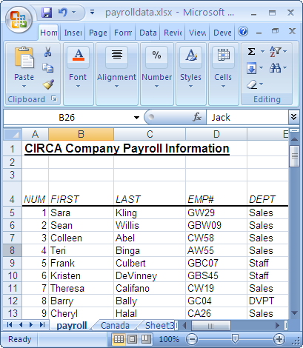
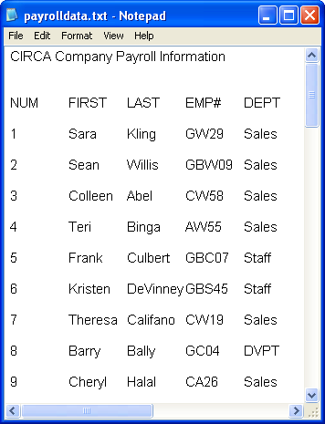
Export Excel Data (Contd.)
The following figures shows the export of Excel data to Notepad.
Data in Excel
Data after exporting to Notepad

Slide 36
Demo: Exporting Excel Data to Use in Microsoft Word
Scenario:
  Your manager has signed off on the data contained in the Payroll Data workbook. Now you need to make this data available in Word so that you can use the application’s mail merge feature to distribute payroll information to all the employees listed in the Payroll Data workbook.

Slide 37
Demo: Exporting Excel Data to Use in Microsoft Word (Contd.)
Solution:
  To solve the preceding scenario, you need to perform the following tasks:
    Save the Payroll worksheet as a tab delimited text file.
    View the content of Payroll Data.txt in Word.
Notes:
Discuss the scenario of Activity 6-1 of Lesson 6 in the Student Guide with the students.
You can access the data file for this activity from the following path in the TIRM CD:
TIRM\DATAFILES FOR FACULTY\LEVEL 3\Session_03\Importing and Exporting Data\Payroll Data.xlsx

Slide 38
Import a Delimited Text File
File import is a method of capturing data from one application for use in another application.
Excel can import all the data or selected data from a file.
You can split data to different columns by importing delimited text files into Excel:
  This gives you the flexibility to format and manipulate data with Excel’s toolset.
Delimited text file is a TXT file that contains data fields separated or delimited by certain characters.

Slide 39
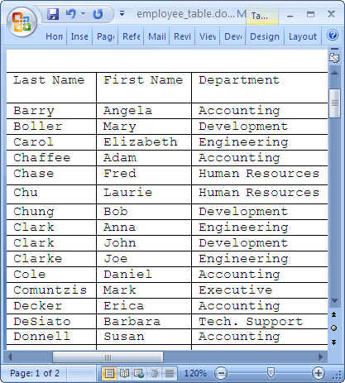
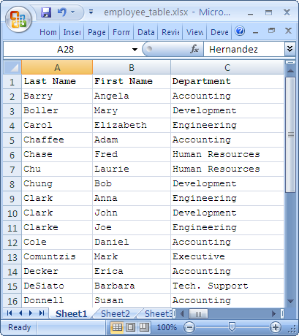
Import a Delimited Text File (Contd.)
The following figures show the data in an Excel worksheet after importing it from Word.
Table in a Word document
Table after importing to an Excel worksheet

Slide 40
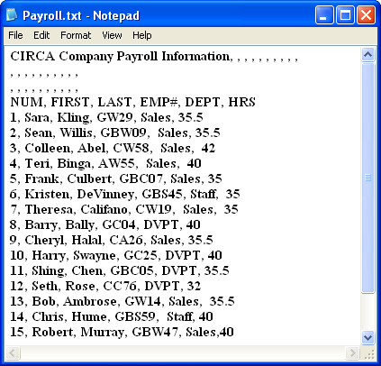
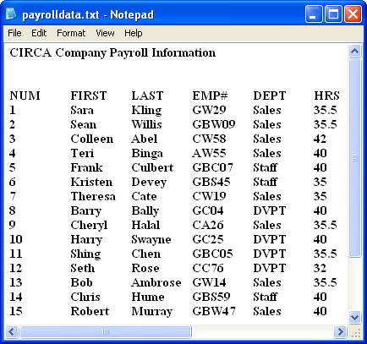
Import a Delimited Text File (Contd.)
The following figures show two delimited text files with two different characters used to delimit data in TXT files.
Data separated
by commas
Data separated
by tabs

Slide 41
Import a Delimited Text File (Contd.)
The Get External Data group contains the following commands used to import data from other applications into Excel:
  From Access
  From Web
  From Text
  From Other Sources
  Existing Connections

Slide 42
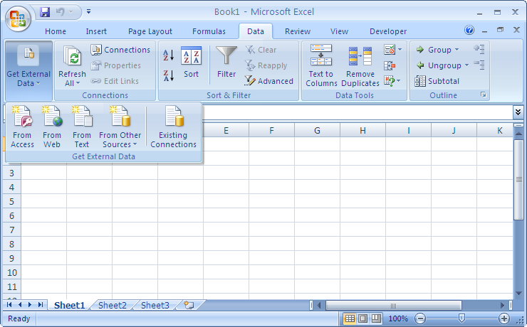
Import a Delimited Text File (Contd.)
The following figure shows different commands in the
Get External Data group.
Commands in the
Get External Data group

Slide 43
Demo: Importing a Delimited Text File
Scenario:
  The Payroll text file is a comma-delimited text file which contains the employee payroll data. You have been tasked with converting the comma-delimited file into an Excel file so that the employee payroll data can, going forward, be stored in Excel and can reflect all the changes made to the text file every time the text file is updated.

Slide 44
Demo: Importing a Delimited Text File (Contd.)
Solution:
  To solve the preceding scenario, you need to perform the following tasks:
    Select the Payroll text file to import into Excel.
    Specify the delimiter settings for the text to be imported.
    Set the import properties for the delimited text.
Notes:
Discuss the scenario of Activity 6-2 of Lesson 6 in the Student Guide with the students.
You can access the data file for this activity from the following path in the TIRM CD:
TIRM\DATAFILES FOR FACULTY\LEVEL 3\Session_03\Importing and Exporting Data\Payroll.txt

Slide 45
Summary
In this session, you learned that:
  Trendlines are the graphical representation of trends in a data series that allows you to study predictions in data.
  A scenario is a set of input values that are substituted for the primary data in a worksheet.
  The Solver Parameters dialog box consists of options that can be used to set the solver parameters.
  The Analysis ToolPak is an add-in that contains a wide variety of tools to help you perform statistical analysis.
  A workspace is used to manage related sets of data that span across multiple workbooks.
  Data consolidation is the method of summarizing data from several ranges into a single range.
Notes:
Use the Summary slides to summarize the session.

Slide 46
Summary (Contd.)
  The linked cells can smooth the workflow by removing the need to open workbooks that contain related data.
  The links can be edit to change the reference to a linked cell in your source workbook.
  File export is a method of sending data that has been created in one application to a different application.
  Delimited text file is a TXT file that contains data fields separated or delimited by certain characters.
Notes:
Use the Summary slides to summarize the session.

